Slide 1
Trauma Informed Practices: Achieving that state of “attentive calmness”
Jennifer Johnson, MSW, LCSW

Slide 2
? Trauma Informed ?
Trauma is a relatively frequent occurrence. More than half of children and adolescents in the United States have experienced an event that is potentially traumatic. These events include: child maltreatment; witnessing domestic violence; exposure to community violence; being a victim of bullying; being involved in a serious accident, fire, or disaster; medical trauma; or the sudden loss of a loved one (Cohen, Berliner & Mannarino, 2010).
Notes:
Most neurotypical children want to please and become addicted to the looks on the faces of those adults around them when they do please. If a child has expereinced trauam or chrnic distress then we have changes in the brain – meaning they are not necessarily neurotypical -they can heal and recover – returning to a state of neurotypical

Slide 3
Something Different

Slide 4
How to know if someone is recovered from their trauma?
The trauma is integrated into ones story but the trauma is not
THE STORY !

Slide 5
Varying Effects

Slide 6
Trauma can affect the child’s developing brain. Children who become hyper-alert may not be able to attend to academic material. Learning requires a state of attentive calmness. Traumatized children can show difficulty with concentration, retaining information, processing and understanding new information, planning and organization, and other cognitive skills. Language skills in particular are thought to be susceptible to disruption.

Slide 7
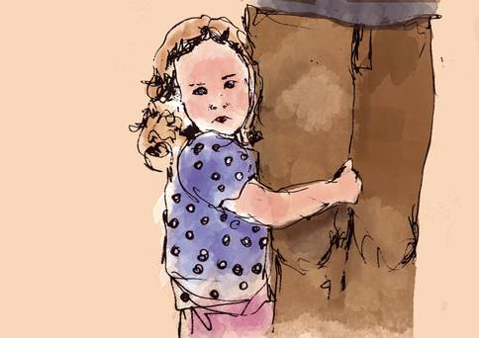
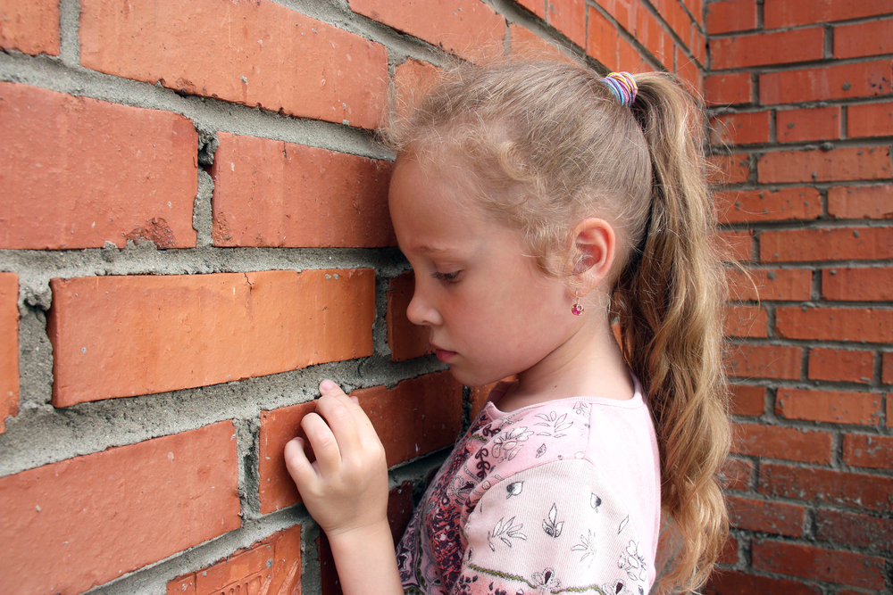
Attachment and relationships can change. Trauma can disrupt a child’s key relationships and make them wary of others. Children may become isolated, have few social skills, and lack sources of support. Some children may be clingy, chronically anxious, emotionally needy, and lack boundaries.

Slide 8
Behavioral control may be challenging. Traumatized children may have poor impulse control or be overly constricted. Some show oppositional behaviors, aggression, and other acting out behaviors.
Notes:
Many times the individual is not even angry at the person they stuck out at – they are angry in genereal – angry about the traumatic event and not understanding why it happened or why it continues to happen – so just angry in general – which is often why they say they don’t know why they hit so and so.

Slide 9
Physical health can be affected. Sleeping patterns and eating patterns may be disturbed. Some children may express anxiety through somatic complaints. Maltreatment can change the endocrine system, including disruption of arousal and immune functioning. Puberty can be accelerated.

Slide 10
Self-concept can change due to trauma. There may be issues with shame, guilt, body image and self-worth.
Notes:
Its hard being at school where all of this is on display for peers and for teachers

Slide 11
Emotional regulation can be affected. Children may become withdrawn, anxious or depressed.
Children may fail to recognize their feelings and be unable to adjust them appropriately.
Notes:
Regualte – they can see and feel when you are not regulated – why ? Because typically during their times of trauma or chronic distress there was lots of emotional dysregualtion - so they know it and they can spot it in others and then it exacerbates or worsens their current ability to emotionally regulate. Its hard to put yourself together when you are in the presence of someone not being put together but instead someone is angry, or furious or disgusted ( and often at them)

Slide 12
A Little Neurobiology Review

Slide 14
Hand Model of the Brain https://www.youtube.com/watch?v=qFTljLo1bK8&list=PL2dmmhXX2Y9tc7de6eGovuNWfj8m37X_E&index=3

Slide 15
Amygdala sets the alarm off for:
Notes:
alarm system sends a signal to the rest of your brain and your body your heart starts racing so the oxygen is pumped around your body to your muscles so that you're ready for action a number of hormones and neurotransmitters are released such as cortisol adrenaline and noradrenaline this is your body's fight flight freeze response your body has prepared you very quickly how to respond to maximize your chance of survival

Slide 16
Hippocampus
normal memories are stored
generally organized, categorized and sequential
verbally accessible
control over the retrieval of these memories
time-tagged – know when they happened
can be updated by new information
connected to a number of higher function brain regions - involved in regulating emotions, language and abstract thought
Hippocampus helps you to process, interpret and contextualize information

Slide 17
During times of extreme trauma
in order for your brain and body to respond quickly and efficiently your hippocampus goes offline this means that in times of extreme trauma information is not processed in the same way and your brain stores a different type of memory - a trauma memory.

Slide 18
Trauma memories have different characteristics than normal memories
generally not well organized and sequential - they are fragmented
you have little control over the retrieval of these memories which means they tend to come back involuntarily without warning
they are situationally accessible which means they are usually triggered by reminders in the environment
they are not time tagged which means it's hard to place when they happened
Notes:
There is evidence that trauma is stored in the part of the brain called the limbic system (amygdala) , which processes emotions and sensations, but not language or speech. That’s why part of treatment is abou creating a trauma narrative – putting spech and language to the event in hopes of organinzing it and exiting the amgydala and placing in the hippocampus.

Slide 19
There is evidence that trauma is stored in the part of the brain called the limbic system (amygdala) , which processes emotions and sensations, but not language or speech. That’s why sometimes treatment is about creating a trauma narrative – putting speech and language to the event in hopes of organizing it and having it exit the amygdala and placing it in the hippocampus.
Notes:
Overactive stress hormones can alter neural connections. When neural connections are altered, hypersensitivity to danger cues can emerge and spontaneously trigger automatic fear responses. The resulting condition can cause children later to misinterpret visual cues, in addition to experience depression, hyperanxiety, attention deficit and aggression.

Slide 20
Trauma Memories
it feels like these memories are frozen in time and when they come back it's like they're occurring again now in the present
when they come back they tend to be associated with all of the same emotions and unpleasant physiological sensations that someone experienced at the time of the trauma
Why – Intrusive memories: experts think that in the aftermath of a traumatic experience your brain is attempting to process these memories and put them back into the filing system.
following a traumatic experience almost everyone will experience these intrusive fragments of memory
Notes:
Horowitz originally proposed (1978) that the repetitious replaying of the painful memories actually functions to modify the emotional response to the trauma resulting in a gradual increase in tolerance for traumatic content. Most people actually heal by integration and acceptance of the traumatic experience through this repetition, unfortunately others develop the persistent patterns of hyper arousal and avoidance (known as PTSD). In these individuals the traumatic memory does not become accepted as part of their past.

Slide 21
Remember
As the brain grows and organizes, the higher more complex areas begin to control the more reactive and primitive functioning of the lower parts of the brain, such as the limbic system, in a normal individual.
An individual’s ability to control their impulses and behavioral response to strong emotions requires modulation (logical thinking and problem solving before reacting) of the more primitive parts of the brain by the more sophisticated cortex.
Notes:
Chronic arousal of the SNS fight or flight response can have a negative impact on the development of the higher brain functions (logic, language, impulse control , planning).
Simply, the more sophisticated and complex the survival network becomes, the more difficult it will be for higher cortical functions to subdue it during learning, concentration, and recall

Slide 22
Seat on the Bus
Keep in mind that there are no specific set symptoms of trauma. Trauma experiences vary. They occur at different ages and stages in the child’s life. Children bring with them a variety of skills, attitudes, beliefs and prior experiences. A well-functioning child with a good support system may interpret traumatic events differently than a child who had challenges and vulnerabilities or little support prior to experiencing traumatic events.

Slide 23
Dr. Dan Siegel https://www.youtube.com/watch?v=ZcDLzppD4Jc&index=4&list=PL2dmmhXX2Y9tc7de6eGovuNWfj8m37X_E
Notes:
https://www.youtube.com/watch?v=ZcDLzppD4Jc&index=4&list=PL2dmmhXX2Y9tc7de6eGovuNWfj8m37X_E

Slide 24
Help Name It !

Slide 26
High Road – Low Road & Negative Bias https://www.youtube.com/watch?v=Mp-Q_UU6Ksk&spfreload=10

Slide 27
Healing & Recovery
Treatment
Relaxation and Self-Regulation Skills
Building & Maintaining Healthy Relations

Slide 28
Trauma created pathways
I’m not okay, I’m not safe, others are dangerous, I’m unworthy, I don’t deserve better, the world is unpredictable, people are unpredictable, boundaries are not respected, I shouldn't trust anyone…

Slide 29
Neural Replacement Activities
To heal the brain, a child’s lifestyle and social routine must incorporate consistent and frequent replacement exercises that build new patterning about safety, predictability, self awareness, self confidence and nurturing.
Notes:
https://changingmindsnow.org/stories

Slide 30
Teachers often serve as a “Do-Over” Typical therapeutic issues: trust, boundaries and secrecy
Boundaries are important
What the students says is important and worthy
Introduce ‘freeze” words (no, don’t, stop)
Create opportunities for external clarification, support or help – (referee)
Keeping your word –establishes trust
Notes:
Freeze words: Explain that some don’t know how important it is to know these freeze words – they never learned that and so sometimes they end up hurting other people even people they love.

Slide 31
When Everyone Knows…
If they are developmentally able to understand, further explain that their bodies are responding (jumpy or nervous) because of something that scared them in the past. A false alarm was set off within their bodies. The false alarm was triggered by something that reminded them of their past scary experience. Under the circumstances, their response was natural. When they have a chance to check to see if they’re in real danger, they can recognize they are not in danger and can begin to manage their feelings.

Slide 32
Healing
Drink cold water (not soda or other beverages).
Walk or otherwise move around you or another safe person. Repeat what you are telling them about their immediate safety.
Urge them to know they are okay.
Urge them to know their bodies are upset, but they are okay. Their feelings will pass!
Urge them to know they can literally look around their immediate setting and let you know why they are safe.
Urge them to know they are not responsible for their fear. It is a normal physical response after being frightened in the past.
Urge them to know they are extremely brave.

Slide 33
Six suggestions to help achieve that state of attentive calmness where learning can take place !

Slide 34
Deep Breathing: The slower and deeper the better.
Therapistaid.com
Sesame Street: Common and Colbie Caillat - "Belly Breathe" with Elmo
Pbs.org
Calming breathing exercises for kids
Notes:
https://www.youtube.com/watch?v=_mZbzDOpylA belly breathe

Slide 35
Some of Us Hang Out in Dangerous Areas in our Mind
Here and Now:
Live and Heal
Past events: traumatic or unpleasant
Futuristic worries… ‘what if’s’

Slide 36
5 Step Grounding Technique
1. Jen, stop thinking about this for now!
2. Where am I ?
3. Who am I with?
4. What is the task at hand?
5. What are three objects in my environment?
Notes:
Game to conceptualize this - mix pieces of paper with these steps on them individually along with some obvious non-answers. Give client a set time to go through papers and collect the 5 steps to the grounding technique. Advanced: have papers representing another skill or a psychoeducational concept you gone over; example steps to deep belly breaths, description of cortex and amagydala , relation between thoughts and feels and behaviors, primary and secondary emotions . So a paper will say the emotion that experienced in a split second and is many times a negative or scary emotion like sad, worried , fearful is a ______________ emotion.
Or just hide the 5 steps – hunting for answers - engaging, movement, fun, trusting ….

Slide 37
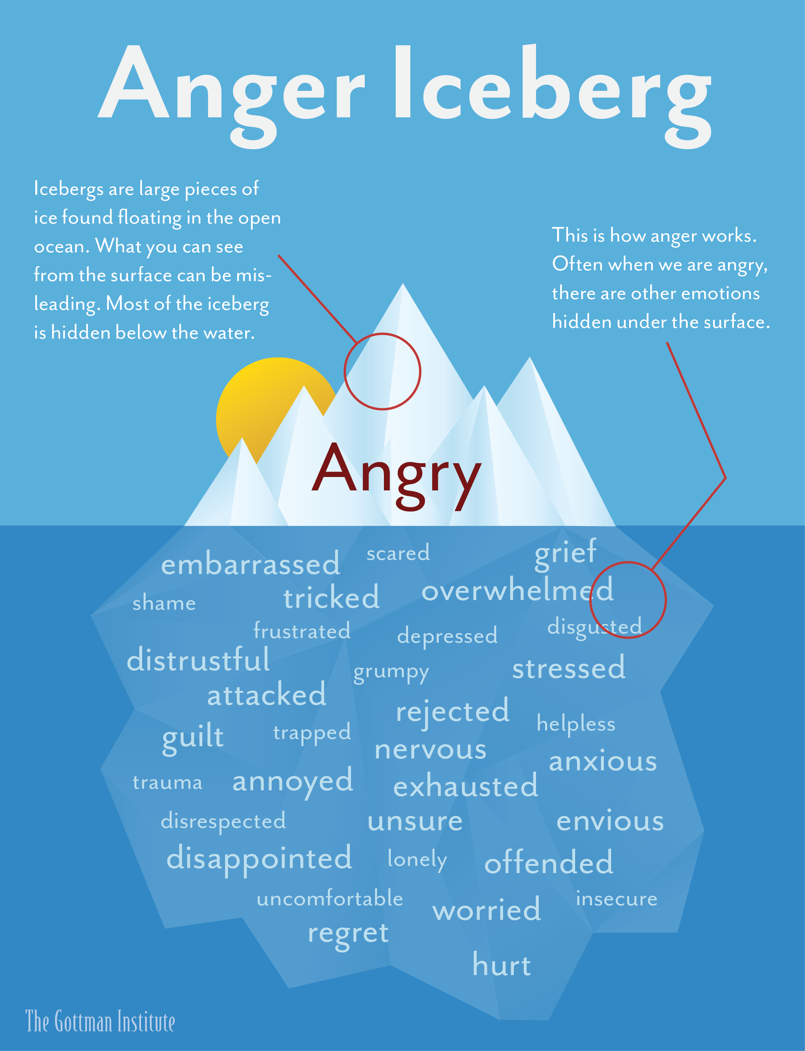

Slide 38
Experiencing Your Emotions
As uncomfortable as your emotions may be, they wont hurt you. They are just your body’s way of trying to communicate with you. Remind yourself that most emotions peak fairly soon after you notice them and dissipate shortly afterward.
Notes:
https://www.youtube.com/watch?v=GVWRvVH5gBQ 5 min video on mindfulness – release of emotions
https://www.youtube.com/watch?v=S45YDJZLjW8 susan davids 2 minutes

Slide 39
Mindfulness https://www.youtube.com/watch?v=a_hPelcPRTg
Notes:
https://www.youtube.com/watch?v=LPe6aP06kZQ – Dr. Gehart the chime – making our brains stronger

Slide 40
Check Out
Notes:
https://www.calm.com

Slide 41
Understanding Negative Bias and Changing Brain Structure
TED talk 14 min Hardwiring Happiness: Dr. Rick Hanson at TEDxMarin 2013
https://www.youtube.com/watch?v=jpuDyGgIeh0&list=PLZwaG5do7TJ2V_O_VKL2YqLNXEKj66WMl

Slide 42
The truth is: Schools help kids heal and recover all the time !

